Slide 1
Online Shopping Portal
Phase 2 Mini Project – QE Batch (Group 2)

Slide 2




Our Team
Mentor
Sunilkumar Bansal
Team Members
Dhimanshi
Bhagya
Thihari
Vindya

Slide 3
Introduction

Slide 4
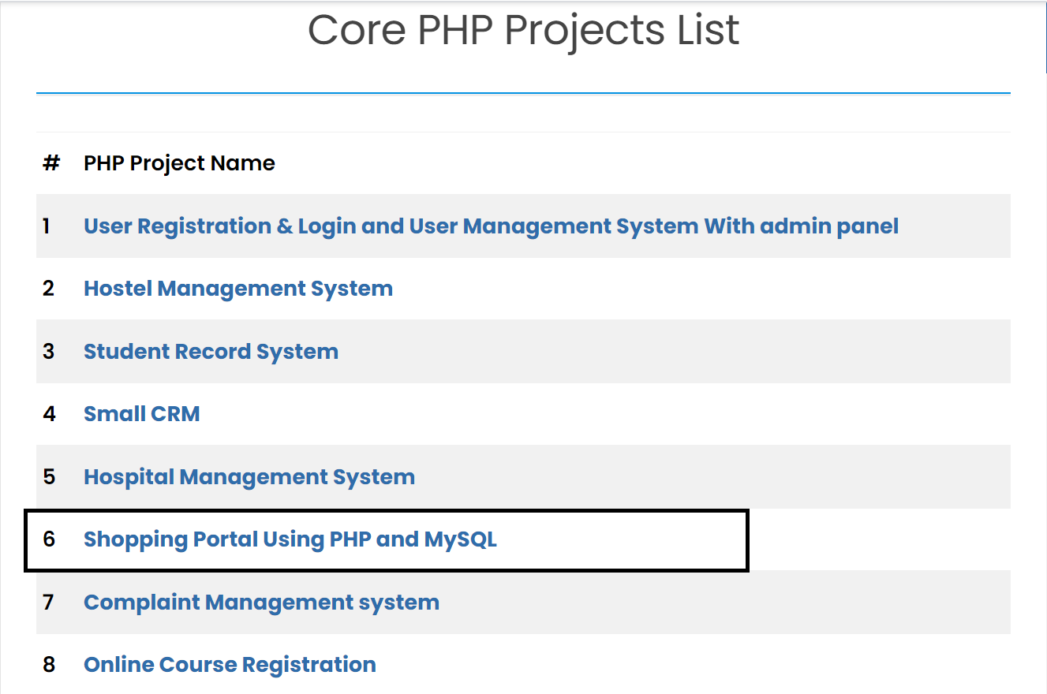
About Our Project
Main Features
User registration
User login system
Change password
Forgot password
Profile management system
Shopping cart
Wishlist
Order history
Track order
Payment pending order
Proceed to checkout
Add to cart

Slide 5
Setting up the environment

Slide 6
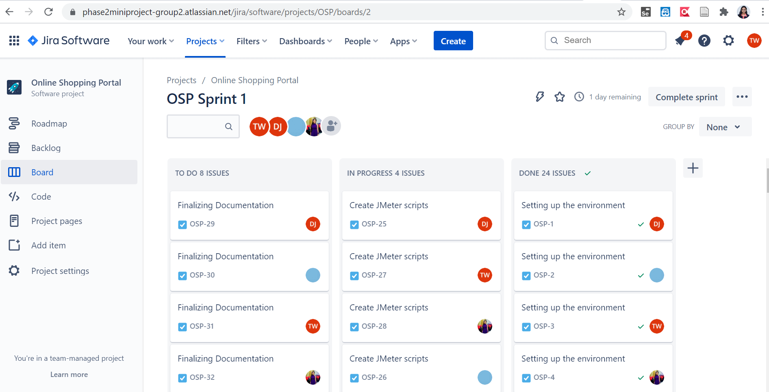
Jira

Slide 7
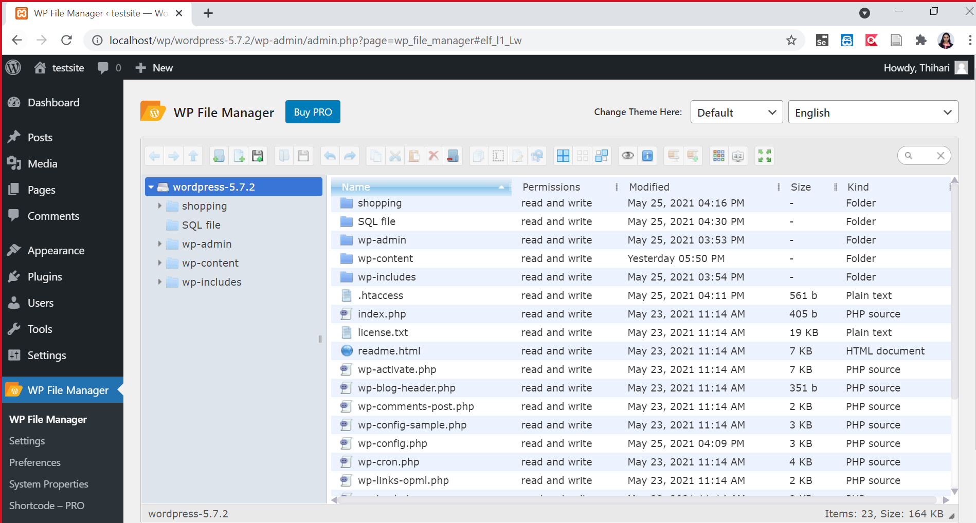
WordPress

Slide 8
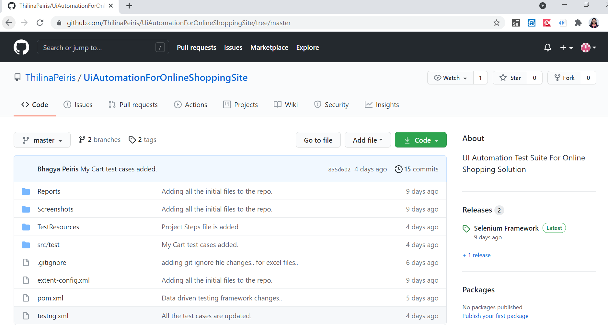
GitHub

Slide 9
Test Case Template

Slide 10
Test Case Template
Test Case Id
Test Scenario
Test Case Description
Preconditions
Test Steps
Test Data
Expected Results
Actual Results
Pass/Fail
Tester
Date
Test Type
Priority
Automated
Comments

Slide 11
Framework

Slide 12
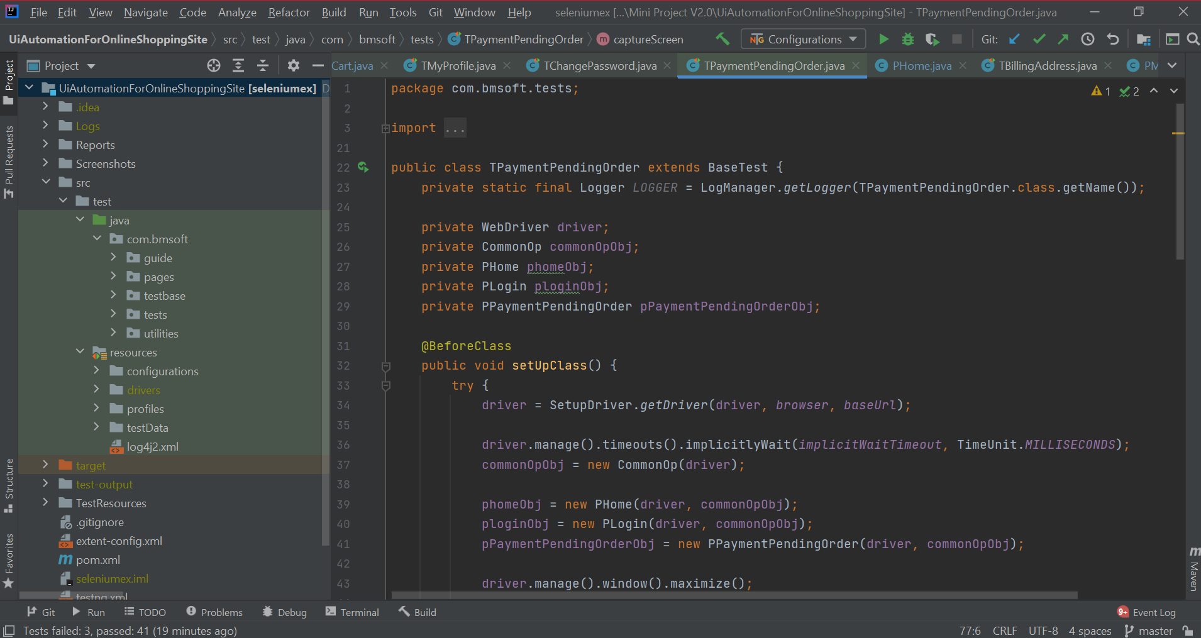
Framework

Slide 13
TestNG Report

Slide 14
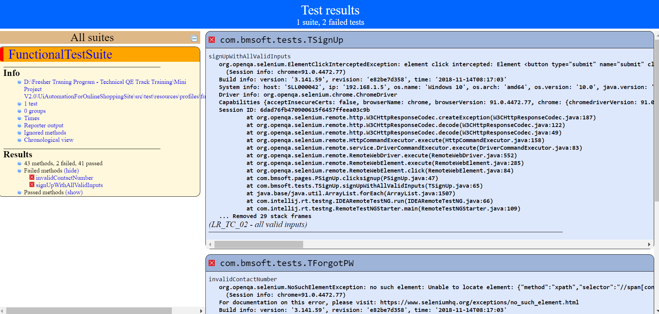
TestNG Report

Slide 15
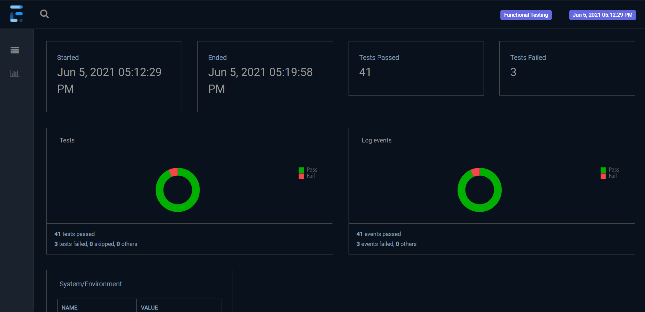
Extent Report - Dashboard

Slide 16
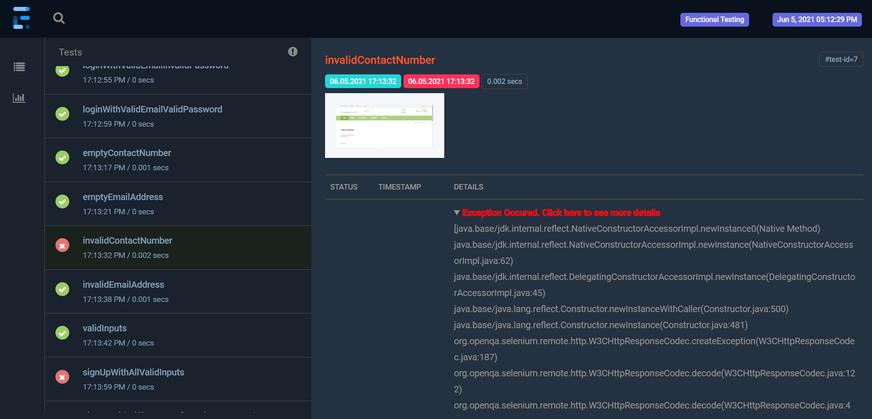
Test Results

Slide 17
JMeter

Slide 18
JMeter Workflows
Login
Registration
Search Product
Track Order
Order History
Change Quantity
Proceed to Checkout
Add to Cart

Slide 19
In JMeter we used…
CSV Data Set
Duration Assertion
Constant Timer
Transaction Controller
Response Assertion
Regular Expression Extractor
Debug Sampler
HTTP Cookie Manager
HTTP Request Defaults
BeanShell PostProcessor
Reports we took…
Assertion Results
View Results Tree
View Results Table
Aggregate Graph
Aggregate Report
Summary Report

Slide 20
Challenges Faced

Slide 21

Challenges
Selecting a suitable working project
Jar file error
“java: error reading C:\Users\dhimanshi_jayasena\.m2\repository\net\bytebuddy\byte-buddy\1.8.15\byte-buddy-1.8.15.jar; ZipFile invalid LOC header (bad signature)”
JMeter regular expression identification
Identifying the latest dynamic value from the regular expression extractor
Missing FAILED test status in automation excel
Forgot to re import the JMeter certificate after 7 days

Slide 22
Learnings

Slide 23

Learnings
Teamwork
Working with WordPress
GitHub command handling
Working with Jira
Automation using POM + DDT (using Excel) approach
Working with JMeter
Regular Expression

Slide 24
Shared Locations
Testcase Document Location: https://persistentsystems-my.sharepoint.com/:x:/r/personal/thihari_wijesinghe_persistent_com/Documents/Mini%20Project%20-%20Group%202.xlsx?d=w5350ce6c691549deb37ac330b4fafb5c&csf=1&web=1&e=AKDCDg
Jira Location: https://phase2miniproject-group2.atlassian.net/jira/software/projects/OSP/boards/2
Project Steps Document Location: https://persistentsystems-my.sharepoint.com/:w:/g/personal/vindya_hasanthi_persistent_com/ESr6JlY2iFNOiScmMasLBFIBtc6qTghSUj8djPUd3FRwjg?e=4%3AVumaMx&at=9&CID=B42DA2F7-79AB-4464-BCC6-A40585E88FA1&wdLOR=cFE11C5BE-E49C-4577-BE4F-990BA1E86A35
Project Git Location: https://github.com/ThilinaPeiris/UiAutomationForOnlineShoppingSite.git

Slide 25
References

Slide 26
References
https://phpgurukul.com/php-projects-free-downloads/
https://www.youtube.com/watch?v=3OFQFiSNx00
https://themeisle.com/blog/install-xampp-and-wordpress-locally/
https://www.swtestacademy.com/data-driven-framework-in-selenium/
https://testautomationu.applitools.com/selenium-webdriver-tutorial-java/
https://regex101.com/
https://mundrisoft.com/tech-bytes/extract-data-from-response-in-jmeter-using-regular-expression-extractor/
https://www.youtube.com/watch?v=KufhkXgwKFQ

Slide 27
Thank you!

